Slide 1
Controlling How the Cookie Crumbles Symposium
Educating and Empowering Entrepreneurs
Sponsored by The Carter Malone Group
February 22, 2014
Floyd Tyler, Presenter

Slide 2
PreserverPartners
Alternative asset management firm started in 2009
Focus on alternative investments (i.e. Hedge Funds and Unconventional Strategies)
40 accredited institutions and wealthy individuals as clients
Top 10% performance record
Hedge funds have cumulative returns of 35% and 53% respectively since inception.

Slide 3
Why I Started Preserver?
Possessed several entrepreneurial traits (self-sacrifice, need for achievement, independent, resilient)
Self-determination
Build a better product and business
Prove a vision
Potential to build wealth

Slide 4
Years of Research: Idea/Concept
Developed a winning idea that solved a real problem
Improve investor experience: Purchase, Delivery, Use
Improve investor utility: Convenience, Simplicity, Risk
Positive feedback from industry professionals and prospects
Research industry, business/investment models of competitors and customers trends
Unique value proposition

Slide 5
Research and Planning: Self and Team Assessment
Why I was positioned to do it?
Personality, aptitude and credentials
Experience and skills
Relationships/network
What team/resources were needed?
Financial/accounting/compliance
Legal/regulatory
Sales and marketing

Slide 6
Research and Planning: Identified Service Partners
Establish a banking relationship for:
Secured lending
Deposit accounts/credit lines
Identify good accountant and auditor with industry expertise
Find a good lawyer with industry expertise
Sought high quality service partners that could lend creditability to a new firm

Slide 7
Financial Planning: Prepare Personally
Live well below means
Saved large portion of salary and bonuses for 4 years prior
Managed personal credit proactively for high score
Set aside funds to run business and household for 3 years each

Slide 8
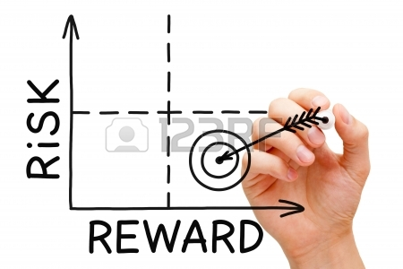
Financial Analysis Confirmed Low Risk
Long-term equity capital to handle early losses and mistakes
Attractive business economics and low capital requirements
Conservatively reach profitability and positive cash flow in year 3
Addressed the common reasons for business failure

Slide 9
Execution: A ‘Low Risk’ Venture
Self-financed with equity capital
No owner equity draws in the first couple of years
Shared office space for first 16 months; Bought used furniture
Used cloud-based technology
Limited initial investment in full-time staff
Negotiated discounts with service providers based on growth
Set timelines for business performance
Set maximum capital outlay for business to allow “career reboot” if unsuccessful

Slide 10
Setbacks and Challenges
Initial seed investor backed out one month before start
Founder had 2 year non-solicitation agreement
Started in middle of recession and during market turmoil
New, small firm in unconventional industry
New, unproven investment strategy
Sales cycle is long
3-5 year track record required by most investors

Slide 11
How We Have Distinguished Ourselves
Product performance: Top 10%
Stressed competitive advantage and key differentiation in all communications with prospects, media and investors
Unique value proposition addresses investor pain points

Slide 12
Positioned for Future
Focus on product performance
Build-out team and operational infrastructure
Manage financials for long-term sustainability
Reinvest in sales, marketing and public relations

Slide 13
Wealth-Building Goals
Multiple Income Streams
Diverse Asset Portfolio
Social Security
Retirement Income
(Annuity, 401K)
Rental Income from Real Estate
Dividend and Interest Income from Taxable Investments
Distributions from Business Interests
Consulting Income
Retirement Savings (Annuity/401K)
Taxable Investments (Stocks/Bonds/Mutual Funds)
Investment Real Estate
Primary Residence
Business Interests

Slide 14
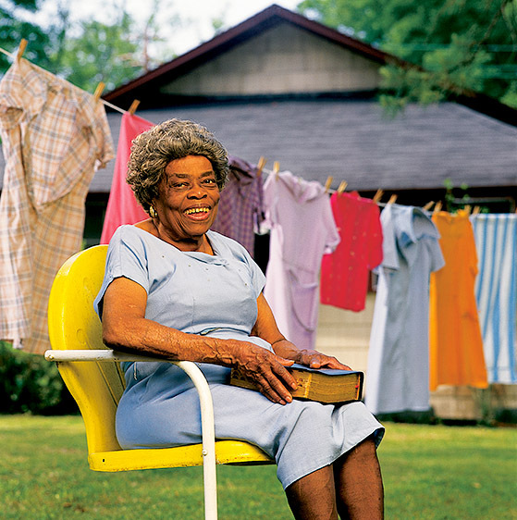
She Did It! You Can Too!
Ms. Osceola McCarty saved over $600,000 doing laundry in Hattiesburg, MS.
“I live where I want to live, and I live the way I want to live. I planned to do this. I planned it myself.”

