Slide 1


Memphis office of resources & Enterprise
Controlling How Your Cookie Crumbles
Making Memphis a “City of Choice” for All

Slide 2

    Poverty in Memphis Challenges and Engages the Entire Community
Overall Poverty Rate: 26.9%
African-American Poverty Rate: 31.9%
Children in Poverty: 39.6%

Slide 3
City Leadership for Minority/Women Business Development is Critical
    With Black/African American population at 61.1% and Female population at 52.5% MWBEs are only 1.3% of Total Business Receipts.
    Total City of Memphis purchasing from MWBEs started at 8% before MBDOC began in 2011, now we are recording 14.7% of spending.
2000 & 2010 Disparity Studies, and Wharton Transition Plan, identified need for City of Memphis to facilitate a coordinated strategy to drive growth in minority business receipt beginning with City of Memphis purchasing and with……

Slide 4

MORE
MORE is an open door for minority and women business owners as well as entrepreneurs seeking to explore the various levels of business resources to start or advance their companies.
In 2011 Mayor AC Wharton Jr. created an institution designed to grow women and minority-owned businesses by providing information and connections with available resources to the citizens of Memphis...He created MORE.
Making MORE your “first stop” assures a clear path to the services and resources necessary to facilitate your objective of doing business with the city, as well as other governmental and corporate organizations.

Slide 5
Step: 1
Set up a face-to-face meetings with our business expert
meetings may take 30-60 minutes
Fill out an intake form that you will be given when an appointment has been set up.
MORE partners are community stakeholders with the same goal as MORE, to grow business in Memphis, TN.
After your assessment, you will be referred to several of our partners to aid in your business affairs.
Step: 2

Slide 6

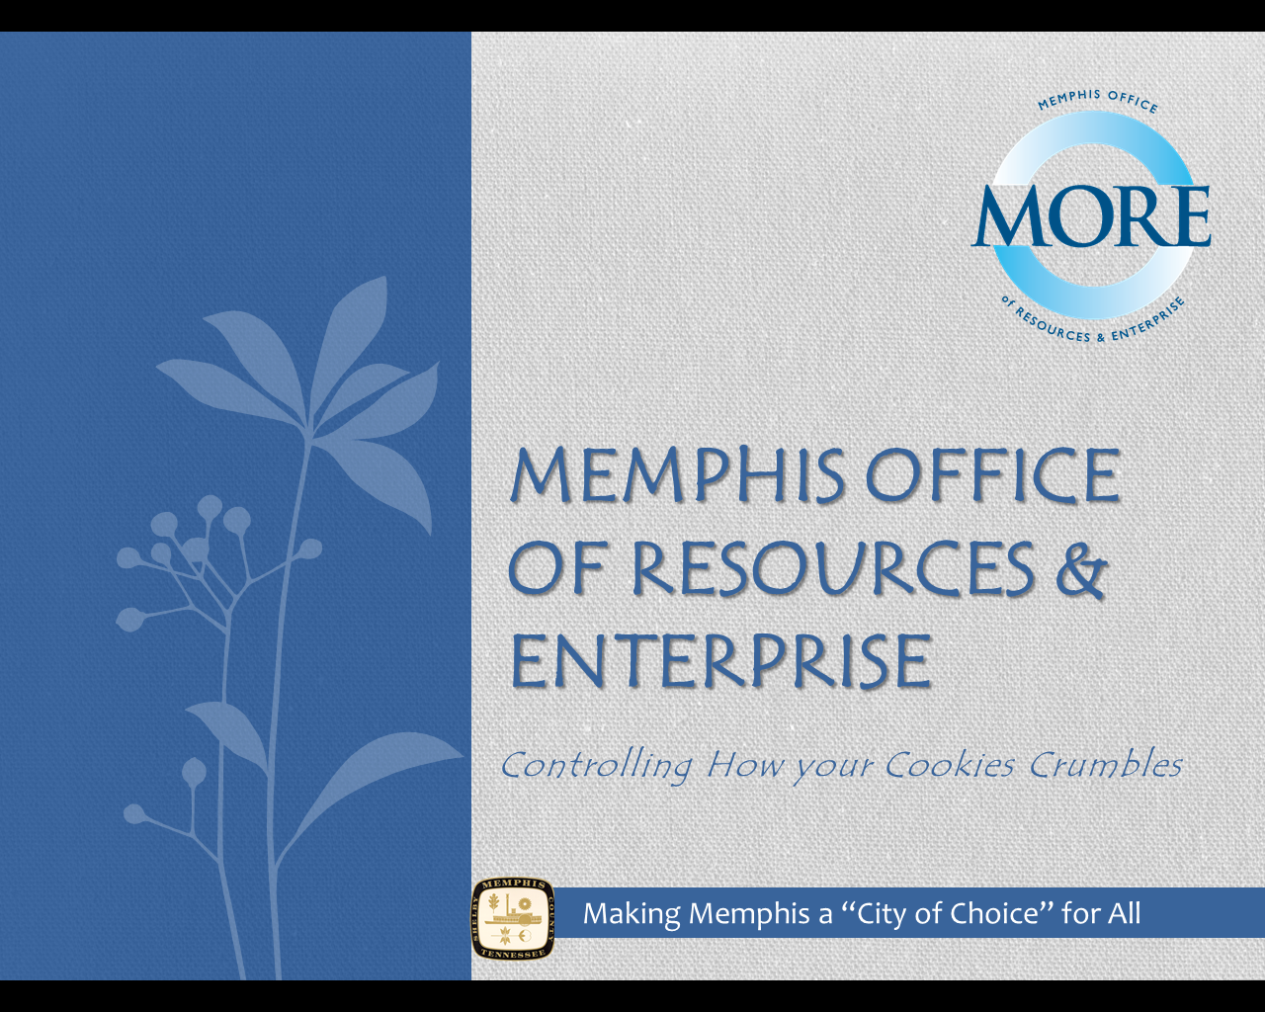

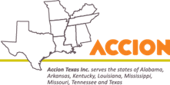




































Library of Resources
Notes:
Mha
Tristate
Homebased
Action capital
Shelby county
Shelby county school

Slide 7


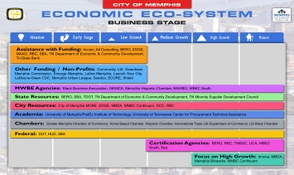
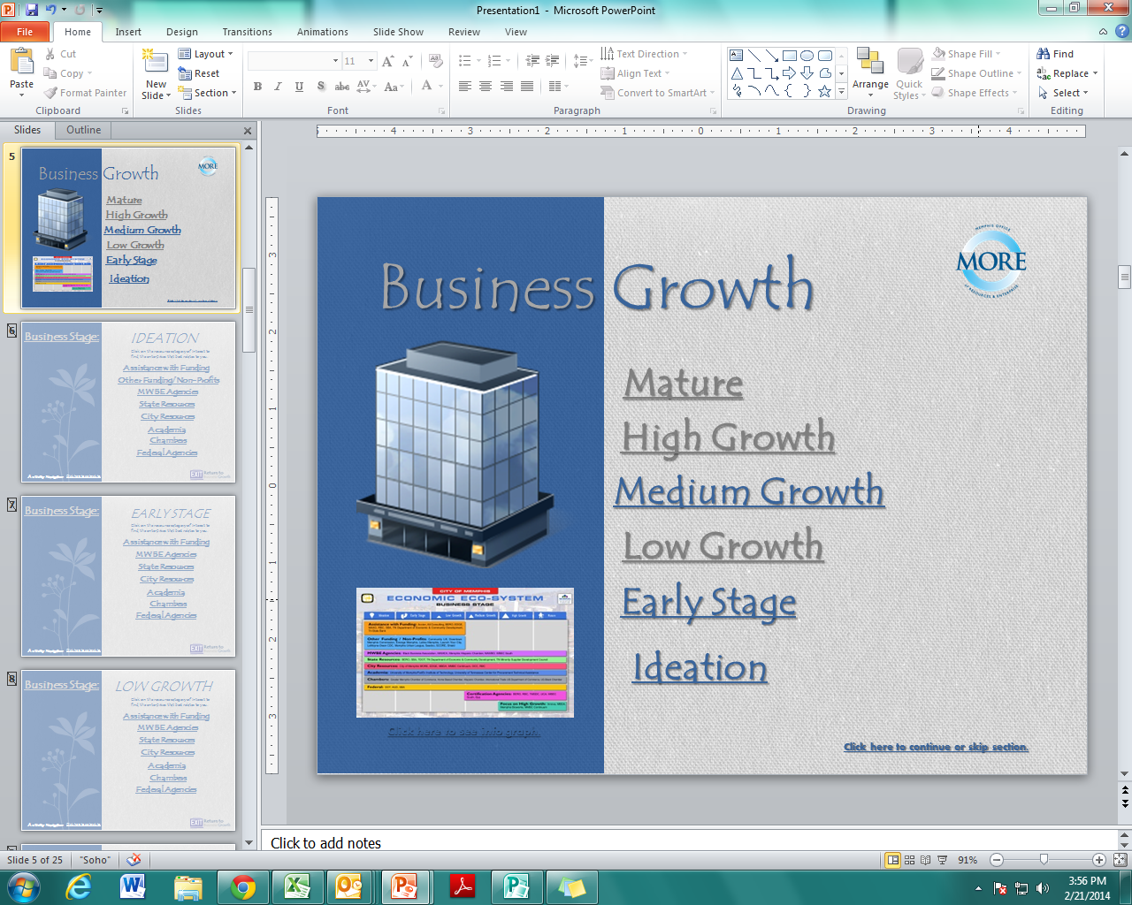
Business Growth
Mature
High Growth
Medium Growth
Low Growth
Early Stage
Ideation
Click here to see info graph.

Slide 8

Ideation
Business Stage:
Click on the resource category of interest to find the enterprises that best relates to you.
Assistance with Funding
MWBE Agencies
Academia
Chambers
City Resources
State Resources
Federal Agencies
Activity Navigator:
Click here to go back to:

Slide 9
Early Stage
Business Stage:
Click on the resource category of interest to find the enterprises that best relates to you.
Assistance with Funding
MWBE Agencies
Academia
Chambers
City Resources
State Resources
Federal Agencies
Activity Navigator:
Click here to go back to:

Slide 10
Low growth
Business Stage:
Click on the resource category of interest to find the enterprises that best relates to you.
Assistance with Funding
MWBE Agencies
Academia
Chambers
City Resources
State Resources
Federal Agencies
Activity Navigator:
Click here to go back to:

Slide 11
Medium growth
Business Stage:
Click on the resource category of interest to find the enterprises that best relates to you.
MWBE Agencies
Academia
Chambers
City Resources
State Resources
Federal Agencies
Certification Agencies
Activity Navigator:
Click here to go back to:

Slide 12
High growth
Business Stage:
Click on the resource category of interest to find the enterprises that best relates to you.
MWBE Agencies
Academia
Chambers
City Resources
State Resources
Federal Agencies
Certification Agencies
Focus on High Growth
Activity Navigator:
Click here to go back to:

Slide 13
mature
Business Stage:
Click on the resource category of interest to find the enterprises that best relates to you.
MWBE Agencies
Academia
Chambers
City Resources
State Resources
Federal Agencies
Certification Agencies
Focus on High Growth
Activity Navigator:
Click here to go back to:

Slide 14
Assistance with Funding
TN Department of Economic & Community Development (ECD)
alt.Consulting
Black Enterprise Resource Office (BERO)
Accion
Renaissance Business Center (RBC)
Economic Development Growth Engine (EDGE)
Memphis Area Association of Government (MAAG)
Small Business Administration (SBA)
Tri-State Bank

Slide 15
Other Funding and Non-Profits
*Community L.I.F.T.
Downtown Memphis Commission
Emerge Memphis
Latino Memphis
*Start Co
Lemoyne-Owen Community College Development Center
Memphis Urban League
Service Corps of Retired Executives (SCORE)
SeedCo
Shield Inc.
Funding agencies denoted by a *

Slide 16
Some MWBE Agencies
Black Business Association (BBA)
Memphis Hispanic Chamber
Memphis Area Minority Contractor's Association (MAMCA)
National Association of Women Business Owners (NAWBO)
Women Business Enterprise Council (WEBEC) South

Slide 17
State Resources
Black Enterprise Resource Office (BERO)
Small Business Administration (SBA)
Tennessee Department of Transportation (TDOT)
Tennessee Minority Supplier Development Council (TMSDC)
TN Department of Economic & Community Development (ECD)

Slide 18
City Resources
City of Memphis
Economic Development Growth Engine (EDGE)
Renaissance Business Center (RBC)
Memphis Office of Resources & Enterprise
Mid–South Minority Business Council (MMBC) Continuum
Office of Contract Compliance (OCC)
Minority Business Development Agency (MBDA)

Slide 19
Academia
FedEx Institute of Technology
University of TN Center for Procurement Technical Assistance

Slide 20
Chambers
Greater Chamber of Memphis Commerce
Memphis Hispanic Chamber
Home Based Chamber
US Black Chamber

Slide 21
Federal Agencies
Small Business Administration (SBA)
Tennessee Department of Transportation (TDOT)
The Department of Housing and Urban Development (HUD)

Slide 22
Certification Agencies
8 (a)
Black Enterprise Resource Office (BERO)
Shelby County (LOSB)
Tennessee Minority Supplier Development Council (TMSDC)
Uniform Certification Agency (UCA)
Women Business Enterprise Council (WEBEC) South

Slide 23
Focus on High Growth
Innova
Memphis BioWorks
Minority Business Development Agency (MBDA)
Mid–South Minority Business Council (MMBC) Continuum

Slide 24
Step 3: Receive Referrals
MORE is an open door for minority and women entrepreneurs seeking to explore the various levels of business resources to start or advance their companies.
In 2011 Mayor AC Wharton Jr. created an institution designed to grow women and minority-owned businesses by providing information and connections with available resources to the citizens of Memphis...He created MORE.
Making MORE your “first stop” assures a clear path to the services and resources necessary to facilitate your objective of doing business with the city, as well as other governmental corporate organizations.

Slide 25
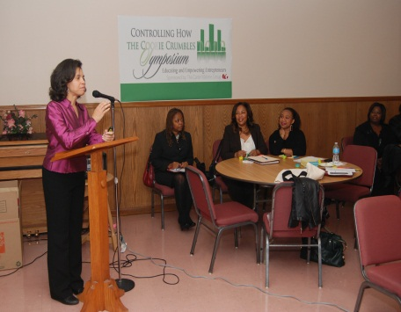
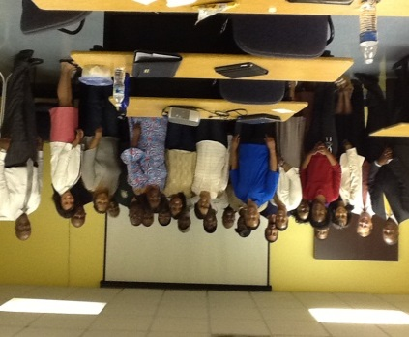
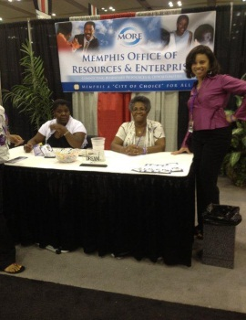
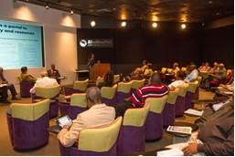
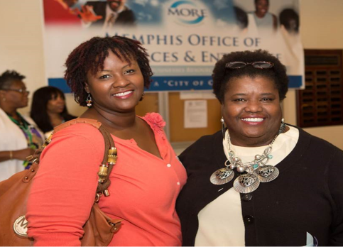
Step 4: Follow up with MORE
We send notifications of bid opportunities, classes and seminars for our clients to attend that are beneficial to their businesses.
We love to hear your feedback after you have met with your assigned partners.
It may be time to take your business to the next level and a new series of referrals are needed.

Slide 26

Interested?
Contact us now!
  Phone number: 901-544-1847
  Email: more@memphistn.gov
  Website: www.morememphis.org

Slide 27




